Slide 1

London Urban Farming Placement Plan
Claude Nortje

Slide 2
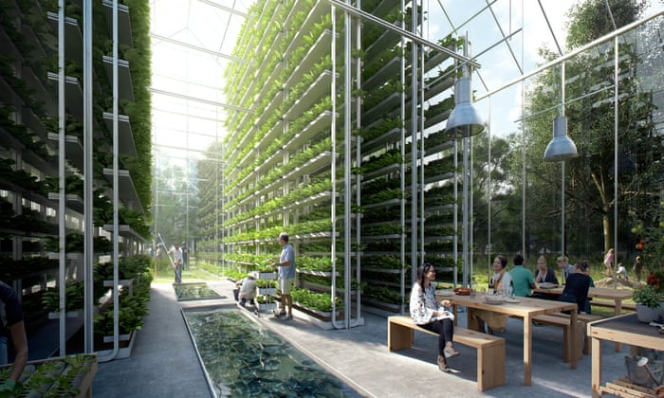
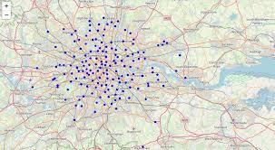
What is urban farming?
Food production in towns, city centers and other densely populated areas
Advanced modern farming techniques
Environmental control and management

Slide 3

Core Focus
Commercial Buildings
Potential customers
Employees & Community

Slide 4
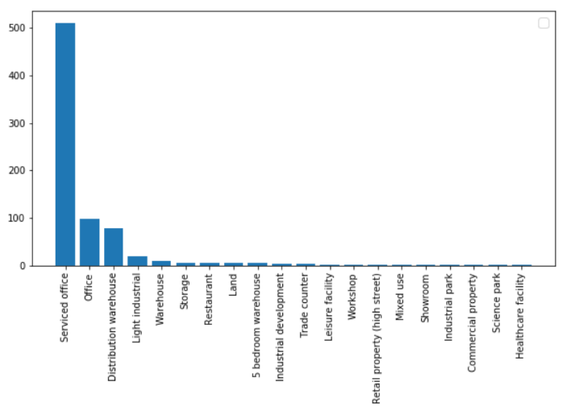
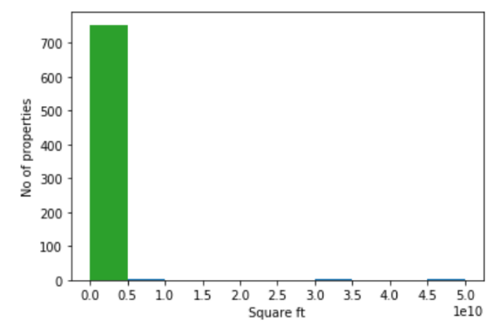
Commercial properties
Types of properties
Properties sizes

Slide 5
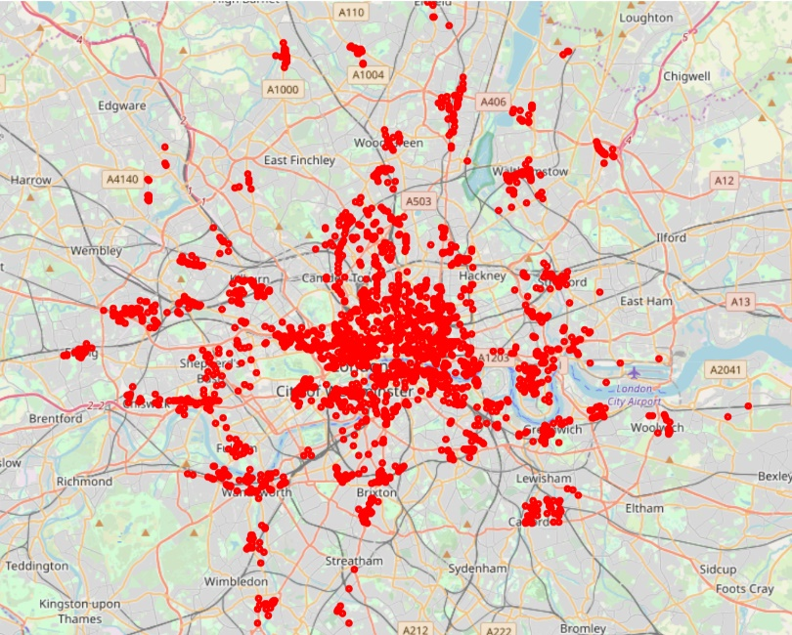
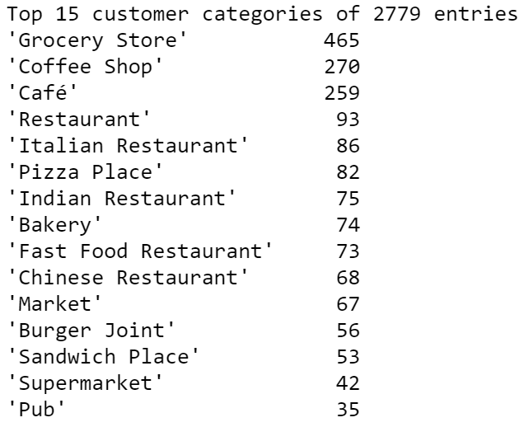
Potential customers

Slide 6
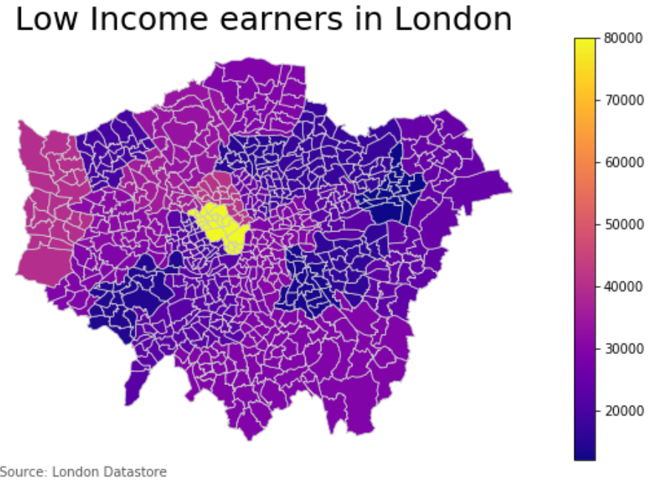
Employees & Community

Slide 7
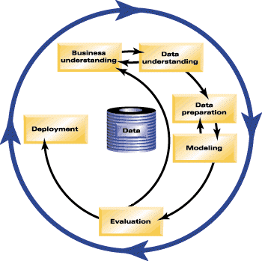
Methodology – CRISP DM
Business Understanding
Data Understanding
Data Preparation
Modeling
Evaluation
Deployment

Slide 8
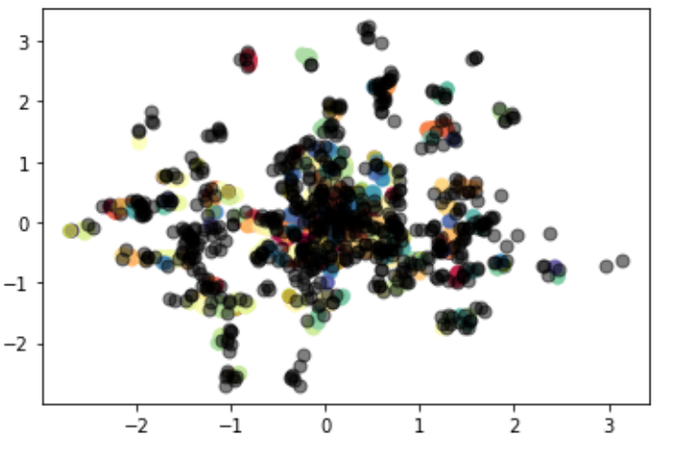
Algorithm - DBSCAN
Radius = Epsilon
MinPts = 3 (Selected point plus neighbours within its radius)
Core Point
Red point has at least 2 neighbouring points within its radius
Border Point
Yellow point has less than 2 neighbouring points within its radius
Noise Point
Black point does not have any neighbouring points within its radius
Epsilon

Slide 9
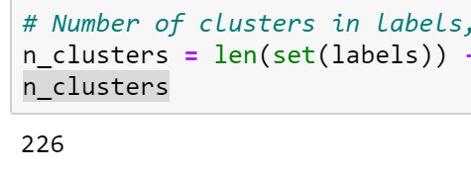
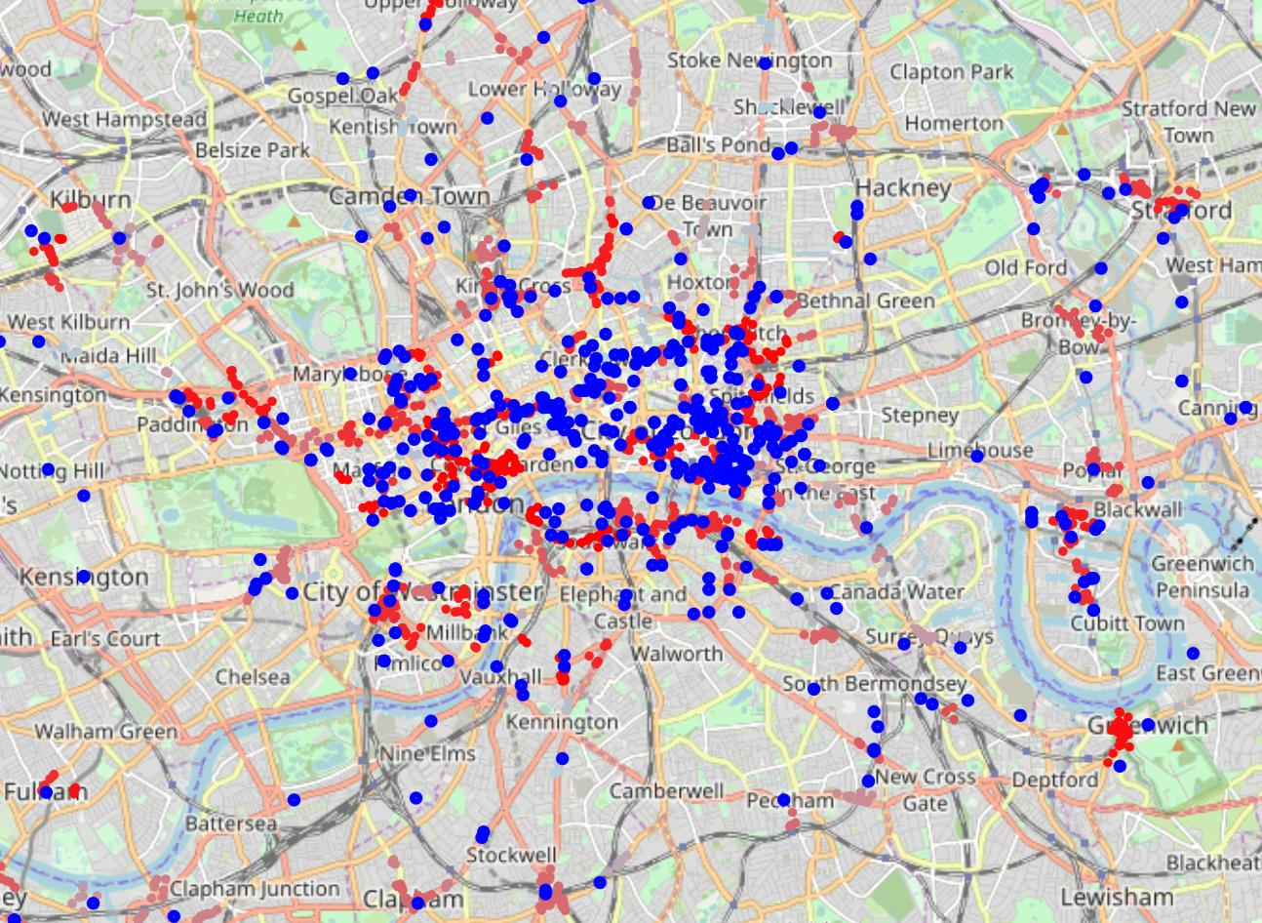
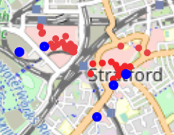
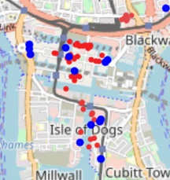
Results

